Slide 1
TURNING TWEETS INTO SENTIMENTS USING TWEEPY
Group - 11

Slide 2



Social Media Usefulness
Collectable
Can we get it?
Measurable
Can we quantify it?
Interpretable
Can we understand it?

Slide 3
Tweepy – great first step
Collectable
Simple call functions
Simple customizations and adjustment
Measurable
Simple and stable output
Packaged and ready for scalable analysis
Interpretable
Easily combined with other libraries
Ready for your customizable use

Slide 4
Use Case: BEST BUY
Product Considerations
Emerging sentiment
Changing sentiment
Product Life Cycle Perceptions
Firm Considerations
Social Media Campaign management
Firm sentiment
Emerging issues
Notes:
Product consideration – what is happening in product sentiment. What is changing? Product life cycle perception we will be selling differently as a procts moves from innovators to early adopters and fromealy adopters to early majority

Slide 5
Informing the floor team leads
Objective understanding of sentiment helps
Tailor product emphasis
Ease customers most likely concerns
Change suggested compliments

Slide 6
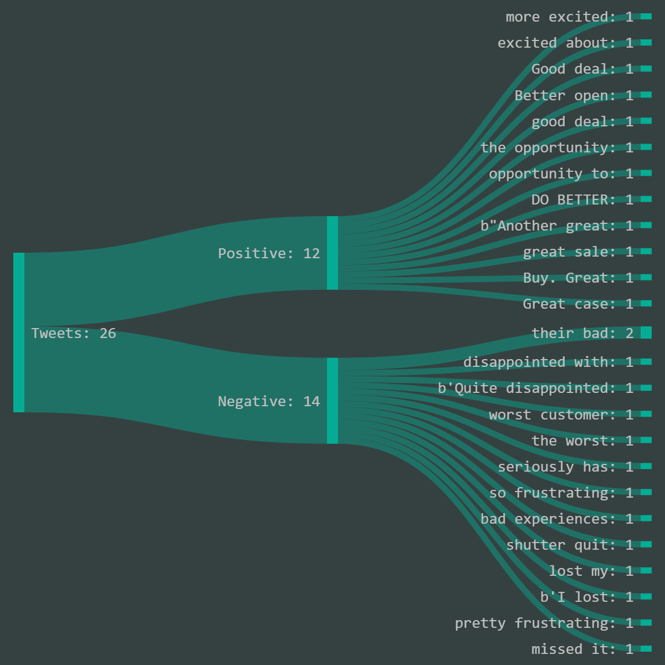
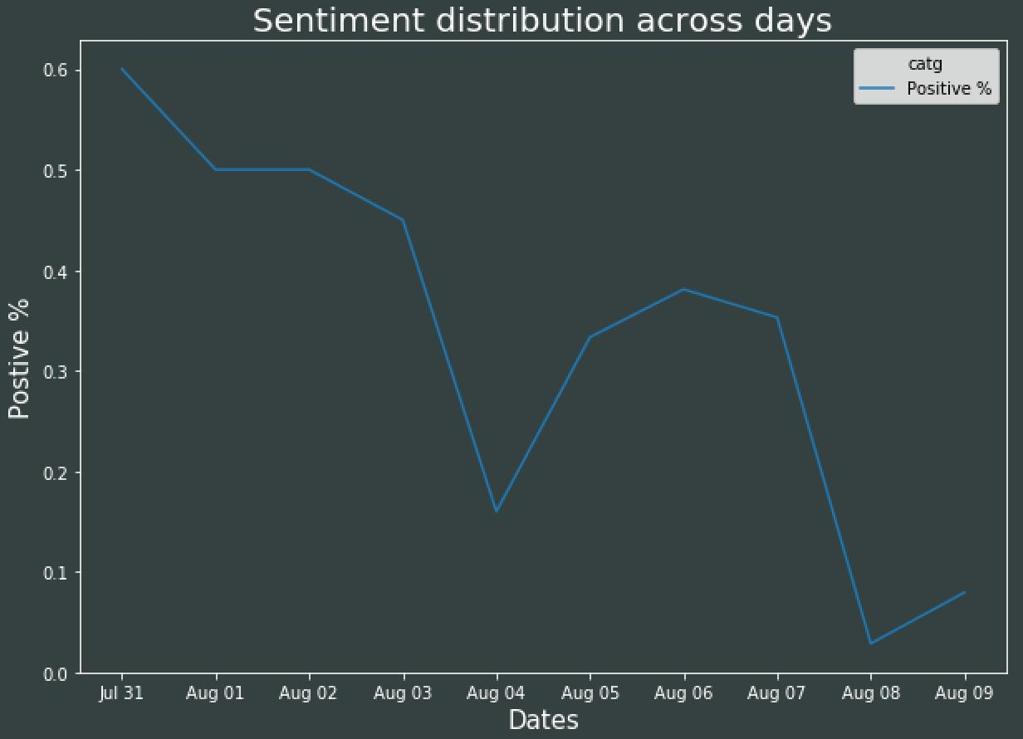
Best Buy and Apple

Slide 7
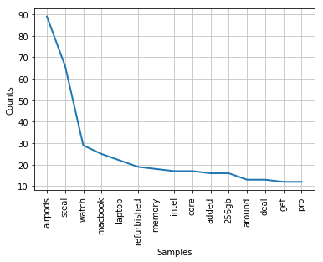
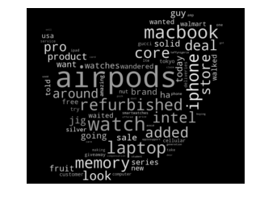
Best Buy and Apple
What is being mentioned the most?

Slide 8
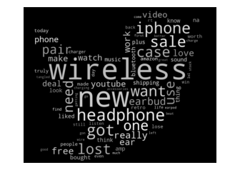
Airpods

Slide 9
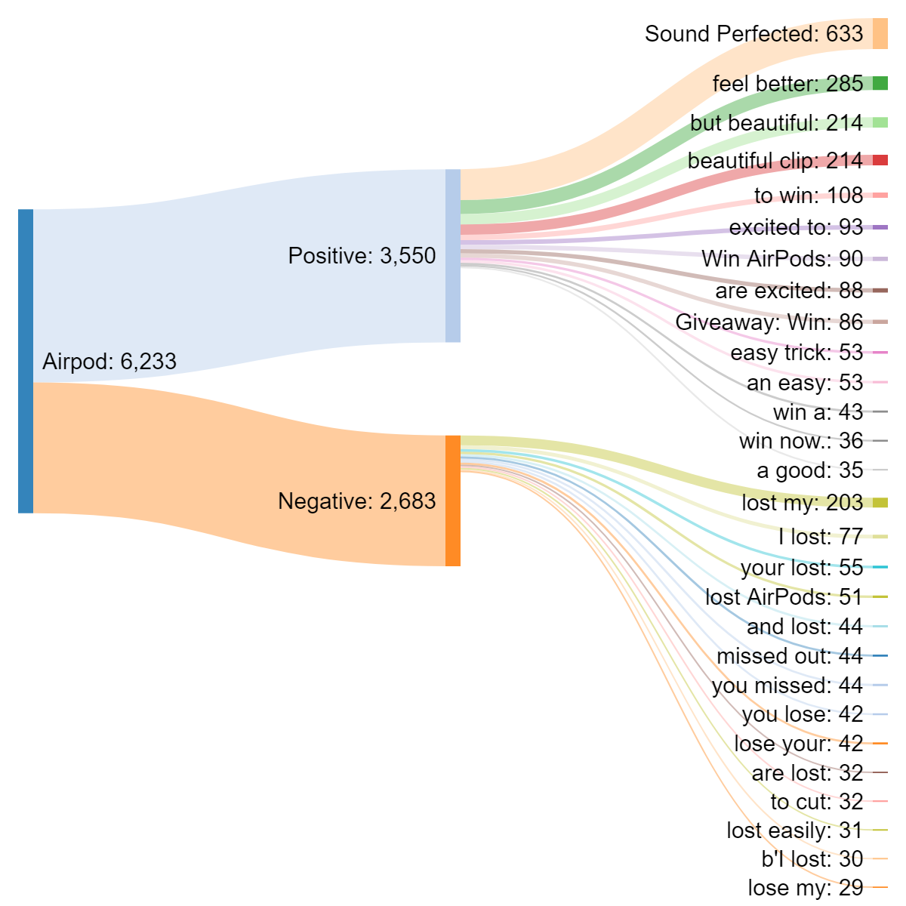
Bi-gram analysis

Slide 10
Applications
Substitutes
Alternative Bluetooth headphones
Bluetooth receiver and aux jack
Solution products
Tethers
Fast Charger
Highlight successful features
Charging case
Sound Quality

Slide 11
Thank you!

